Slide 1
C H A P T E R 2
Input, Processing, and Output

Slide 2
Topics
Designing a Program
Input, Processing, and Output
Displaying Output with print Function
Comments
Variables
Reading Input from the Keyboard
Performing Calculations
More About Data Output

Slide 3
Designing a Program
Programs must be designed before they are written
Program development cycle:
Design the program
Write the code
Correct syntax errors
Test the program
Correct logic errors

Slide 4
Designing a Program (cont’d.)
Design is the most important part of the program development cycle
Understand the task that the program is to perform
Work with customer to get a sense what the program is supposed to do
Ask questions about program details
Create one or more software requirements

Slide 5
Designing a Program (cont’d.)
Determine the steps that must be taken to perform the task
Break down required task into a series of steps
Create an algorithm, listing logical steps that must be taken
Algorithm: set of well-defined logical steps that must be taken to perform a task

Slide 6
Pseudocode
Pseudocode: fake code
Informal language that has no syntax rule
Not meant to be compiled or executed
Used to create model program
No need to worry about syntax errors, can focus on program’s design
Can be translated directly into actual code in any programming language

Slide 7
Flowcharts
Flowchart: diagram that graphically depicts the steps in a program
Ovals are terminal symbols
Parallelograms are input and output symbols
Rectangles are processing symbols
Symbols are connected by arrows that represent the flow of the program

Slide 8
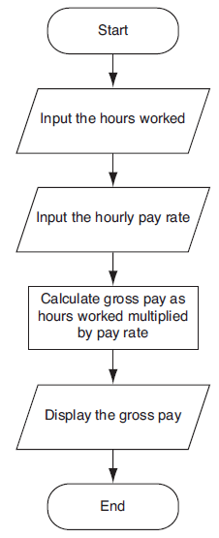

Slide 9
Input, Processing, and Output
Typically, computer performs three-step process
Receive input
Input: any data that the program receives while it is running
Perform some process on the input
Example: mathematical calculation
Produce output

Slide 10
Displaying Output with the print Function
Function: piece of prewritten code that performs an operation
print function: displays output on the screen
Argument: data given to a function
Example: data that is printed to screen
print(“Hello world!”) → Hello world is an argument
Statements in a program execute in the order that they appear
From top to bottom

Slide 11
Strings and String Literals
String: sequence of characters that is used as data
String literal: string that appears in actual code of a program
Must be enclosed in single (‘) or double (“) quote marks
String literal can be enclosed in triple quotes (''' or """)
Enclosed string can contain both single and double quotes and can have multiple lines
print (“””one
two
three”””)

Slide 12
Comments
Comments: notes of explanation within a program
Ignored by Python interpreter
Intended for a person reading the program’s code
Begin with a Pound sign #
End-line comment: appears at the end of a line of code
Typically explains the purpose of that line
print(“David”) #Display the name

Slide 13
Variables
Variable: name that represents a value stored in the computer memory
Used to access and manipulate data stored in memory
A variable references the value it represents
Assignment statement: used to create a variable and make it reference data
General format is variable = expression
Example: age = 29
Assignment operator: the equal sign (=)

Slide 14
Variables (cont’d.)
In assignment statement, variable receiving value must be on left side
A variable can be passed as an argument to a function
Variable name should not be enclosed in quote marks
You can only use a variable after a value is assigned to it

Slide 15
# This program demonstrates a variable.
room = 503
print('I am staying in room number')
print(room)
# Create two variables: top_speed and distance.
top_speed = 160
distance = 300
# Display the values referenced by the variables.
print('The top speed is')
print(top_speed)
print('The distance traveled is')
print(distance)

Slide 16
Variable Naming Rules
Rules for naming variables in Python:
Variable name cannot be a Python key word
Variable name cannot contain spaces
First character must be a letter or an underscore
After first character may use letters, digits, or underscores
Variable names are case sensitive
Variable name should reflect its use
My habit: all small characters with under lines → has_found, test_for_loop

Slide 17
Displaying Multiple Items with the print Function
Python allows one to display multiple items with a single call to print
Items are separated by commas when passed as arguments
Arguments displayed in the order they are passed to the function
Items are automatically separated by a space when displayed on screen

Slide 18
# This program demonstrates a variable.
room = 503
building = “science”
print('I am staying in room number {}’.format(room))
print('I am staying in room number {} at building named {}’. format(room, building))
Use the parentheses to include variable

Slide 19
Variable Reassignment
Variables can reference different values while program is running
Garbage collection: removal of values that are no longer referenced by variables
Carried out by Python interpreter
A variable can refer to item of any type
Variable that has been assigned to one type can be reassigned to another type

Slide 20
Numeric Data Types, Literals, and the str Data Type
Data types: categorize value in memory
e.g., int for integer, float for real number, str used for storing strings in memory
Numeric literal: number written in a program
No decimal point considered int, otherwise, considered float
Some operations behave differently depending on data type

Slide 21
# This program demonstrates variable reassignment.
# Assign a value to the dollars variable.
dollars = 2.75
print('I have', dollars, 'in my account.')
# Reassign dollars so it references
# a different value.
dollars = 99.95
print('But now I have', dollars, 'in my account!')
By python command line
>>> type(1)
<class 'int'>
>>> type(1.0)
<class 'float'>

Slide 22
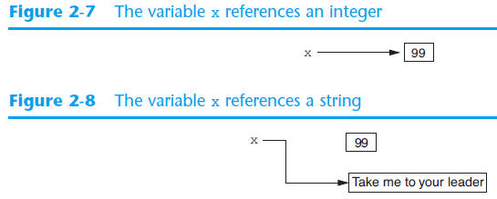
Reassigning a Variable to a Different Type
A variable in Python can refer to items of any type

Slide 23
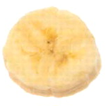
Reading Input from the Keyboard
Most programs need to read input from the user
Built-in input function reads input from keyboard
Returns the data as a string
Format: variable = input(prompt)
prompt is typically a string instructing user to enter a value
Does not automatically display a space after the prompt

Slide 24
# Get the user's first name.
first_name = input('Enter your first name: ')
# Get the user's last name.
last_name = input('Enter your last name: ')
# Print a greeting to the user.
print('Hello {} {}’.format(first_name, last_name))

Slide 25
Reading Numbers with the input Function
input function always returns a string
Built-in functions convert between data types
int(item) converts item to an int
float(item) converts item to a float
Nested function call: general format: function1(function2(argument))
value returned by function2 is passed to function1
Type conversion only works if item is valid numeric value, otherwise, throws exception

Slide 26
How about you input a non-integer value?
# Get the user's name, age, and income.
name = input('What is your name? ')
age = int(input('What is your age? '))
income = float(input('What is your income? '))

Slide 27
Performing Calculations
Math expression: performs calculation and gives a value
Math operator: tool for performing calculation
Operands: values surrounding operator
Variables can be used as operands
Resulting value typically assigned to variable
Two types of division:
/ operator performs floating point division
// operator performs integer division
Positive results truncated, negative rounded away from zero → -2.25 → -3
14//3 = 4, -14//3 = -5, int(-14/3) = -4

Slide 28
# This program gets an item's original price and
# calculates its sale price, with a 20% discount.
# Get the item's original price.
original_price = float(input("Enter the item's original price: "))
# Calculate the amount of the discount.
discount = original_price * 0.2
# Calculate the sale price.
sale_price = original_price - discount
# Display the sale price.
print('The sale price is {}’.format(sale_price))

Slide 29
Operator Precedence and Grouping with Parentheses
Python operator precedence:
Operations enclosed in parentheses
Forces operations to be performed before others
Exponentiation (**)
Multiplication (*), division (/ and //), and remainder (%)
Addition (+) and subtraction (-)
Higher precedence performed first
Same precedence operators execute from left to right

Slide 30
The Exponent Operator and the Remainder Operator
Exponent operator (**): Raises a number to a power
x ** y = x^{y}
Remainder operator (%): Performs division and returns the remainder
a.k.a. modulus operator
e.g., 4%2=0, 5%2=1
Typically used to convert times and distances, and to detect odd or even numbers

Slide 31
# Get a number of seconds from the user.
total_seconds = float(input('Enter a number of seconds: '))
# Get the number of hours.
hours = total_seconds // 3600
# Get the number of remaining minutes.
minutes = (total_seconds // 60) % 60
# Get the number of remaining seconds.
seconds = total_seconds % 60
# Display the results.
print('Here is the time in hours, minutes, and seconds:')
print('Hours: {}’.format(hours))
print('Minutes: {}’.format(minutes))
print('Seconds: {}’.format(seconds))

Slide 32
Converting Math Formulas to Programming Statements
Operator required for any mathematical operation
When converting mathematical expression to programming statement:
May need to add multiplication operators
May need to insert parentheses

Slide 33
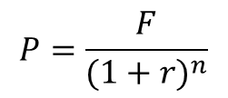
# Get the desired future value.
future_value = float(input('Enter the desired future value: '))
# Get the annual interest rate.
rate = float(input('Enter the annual interest rate: '))
# Get the number of years that the money will appreciate.
years = int(input('Enter the number of years the money will grow: '))
# Calculate the amount needed to deposit.
present_value = future_value / (1.0 + rate)**years
# Display the amount needed to deposit.
print('You will need to deposit this amount: {}’.format(present_value))

Slide 34
Mixed-Type Expressions and Data Type Conversion
Data type resulting from math operation depends on data types of operands
Two int values: result is an int
Two float values: result is a float
int and float: int temporarily converted to float, result of the operation is a float
Mixed-type expression
Type conversion of float to int causes truncation of fractional part

Slide 35
Breaking Long Statements into Multiple Lines
Long statements cannot be viewed on screen without scrolling and cannot be printed without cutting off
Multiline continuation character (\): Allows to break a statement into multiple lines
Example:
print(‘my first name is’,\ first_name)

Slide 36
More About Data Output
print function displays line of output
Newline character at end of printed data
Special argument end=‘delimiter’ causes print to place delimiter at end of data instead of newline character
example:
print(“one”, end=‘ ‘)
print(“two”, end=‘ ‘)
→ result will be one two

Slide 37
More About Data Output
print function uses space as item separator
Special argument sep=‘delimiter’ causes print to use delimiter as item separator
example
print(“one”, “two”, “three”, sep=‘*’)
→ one*two*three

Slide 38
More About Data Output (cont’d.)
Special characters appearing in string literal
Preceded by backslash (\)
Examples: newline (\n), horizontal tab (\t)
Treated as commands embedded in string
Example
Print(‘One\nTwo’)
→ One
Two

Slide 39
More About Data Output (cont’d.)
When + operator used on two strings in performs string concatenation
Useful for breaking up a long string literal

Slide 40
Formatting Numbers
Can format display of numbers on screen using built-in format function
Two arguments:
Numeric value to be formatted
Format specifier
Returns string containing formatted number
Format specifier typically includes precision and data type
Can be used to indicate scientific notation, comma separators, and the minimum field width used to display the value

Slide 41
# This program demonstrates how a floating-point
# number can be formatted.
amount_due = 5000.0
monthly_payment = amount_due / 12
print('The monthly payment is', \
format(monthly_payment, '.2f'))

Slide 42
# This program displays the following
# floating-point numbers in a column
# with their decimal points aligned.
num1 = 127.899
num2 = 3465.148
num3 = 3.776
num4 = 264.821
num5 = 88.081
num6 = 799.999
# Display each number in a field of 7 spaces
# with 2 decimal places.
print(format(num1, '7.2f'))
print(format(num2, '7.2f'))
print(format(num3, '7.2f'))
print(format(num4, '7.2f'))
print(format(num5, '7.2f'))
print(format(num6, '7.2f'))

Slide 43
Formatting Numbers (cont’d.)
The % symbol can be used in the format string of format function to format number as percentage
print(format(0.5, ‘%’)) → 50.000000%
print(format(0.5, ‘.0%’)) → 50%

Slide 44
Formatting Numbers (cont’d.)
To format an integer using format function:
Use d as the type designator
Do not specify precision
Can still use format function to set field width or comma separator
print(format(123456, ‘,d’)) → 123,456

Slide 45
Summary
This chapter covered:
The program development cycle, tools for program design, and the design process
Ways in which programs can receive input, particularly from the keyboard
Ways in which programs can present and format output
Use of comments in programs
Uses of variables
Tools for performing calculations in programs

Slide 46
C H A P T E R 3
Decision structures and Boolean logic

Slide 47
Topics
The if Statement
The if-else Statement
Comparing Strings
Nested Decision Structures and the if-elif-else Statement
Logical Operators
Boolean Variables

Slide 48
The if Statement
Control structure: logical design that controls order in which set of statements execute
Sequence structure: set of statements that execute in the order they appear
Decision structure: specific action(s) performed only if a condition exists
Also known as selection structure

Slide 49
The if Statement (cont’d.)
In flowchart, diamond represents true/false condition that must be tested
Actions can be conditionally executed
Performed only when a condition is true
Single alternative decision structure: provides only one alternative path of execution
If condition is not true, exit the structure

Slide 50
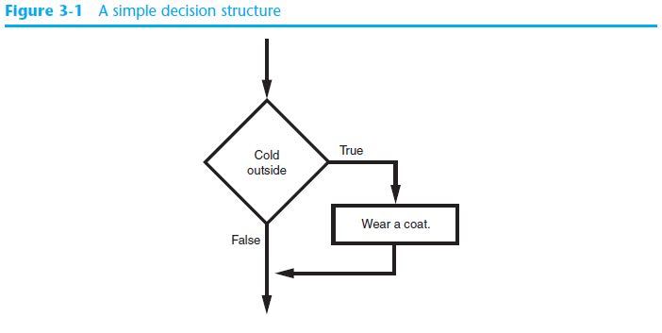
The if Statement (cont’d.)

Slide 51
The if Statement (cont’d.)
Python syntax:
if condition:
Statement ← You have to indent
Statement ← indent should be identical
First line known as the if clause
Includes the keyword if followed by condition
The condition can be true or false
When the if statement executes, the condition is tested, and if it is true the block statements are executed. otherwise, block statements are skipped

Slide 52
Boolean Expressions and Relational Operators
Boolean expression: expression tested by if statement to determine if it is true or false
Example: a > b
true if a is greater than b; false otherwise
Relational operator: determines whether a specific relationship exists between two values
Example: greater than (>)

Slide 53
Boolean Expressions and Relational Operators (cont’d.)
>= and <= operators test more than one relationship
It is enough for one of the relationships to exist for the expression to be true
== operator determines whether the two operands are equal to one another
Do not confuse with assignment operator (=)
!= operator determines whether the two operands are not equal

Slide 54
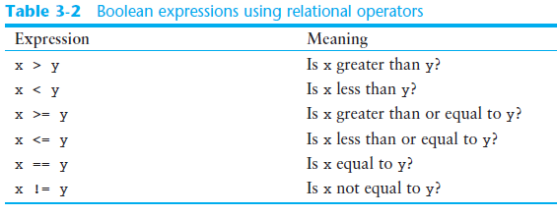
Boolean Expressions and Relational Operators (cont’d.)

Slide 55
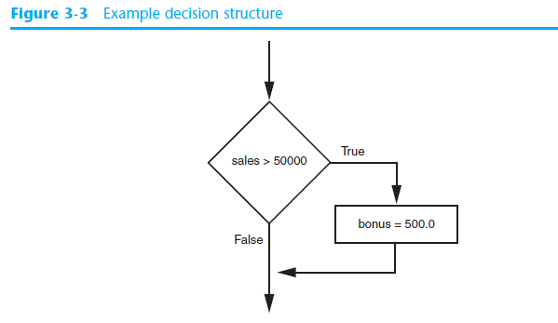
Boolean Expressions and Relational Operators (cont’d.)
Using a Boolean expression with the > relational operator

Slide 56
Boolean Expressions and Relational Operators (cont’d.)
Any relational operator can be used in a decision block
Example: if balance == 0
Example: if payment != balance
It is possible to have a block inside another block
Example: if statement inside a function
Statements in inner block must be indented with respect to the outer block

Slide 57

# This program gets three test scores and displays
# their average. It congratulates the user if the
# average is a high score.
# The high score variable holds the value that is
# considered a high score.
high_score = 95
# Get the three test scores.
test1 = int(input('Enter the score for test 1: '))
test2 = int(input('Enter the score for test 2: '))
test3 = int(input('Enter the score for test 3: '))
# Calculate the average test score.
average = (test1 + test2 + test3) / 3
# Print the average.
print('The average score is', average)
# If the average is a high score,
# congratulate the user.
if average >= high_score:
print('Congratulations!')
print('That is a great average!')

Slide 58
The if-else Statement
Dual alternative decision structure: two possible paths of execution
One is taken if the condition is true, and the other if the condition is false
Syntax: if condition:
statements
else:
other statements
if clause and else clause must be aligned
Statements must be consistently indented

Slide 59
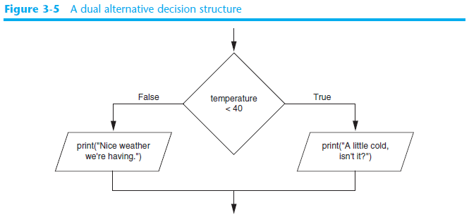
The if-else Statement (cont’d.)

Slide 60
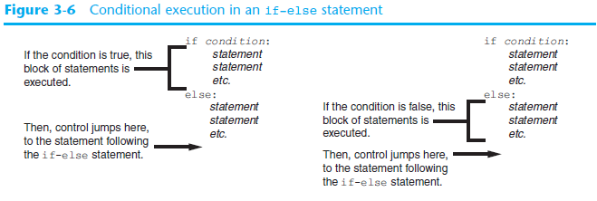
The if-else Statement (cont’d.)

Slide 61
# Variables to represent the base hours and
# the overtime multiplier.
base_hours = 40 # Base hours per week
ot_multiplier = 1.5 # Overtime multiplier
# Get the hours worked and the hourly pay rate.
hours = float(input('Enter the number of hours worked: '))
pay_rate = float(input('Enter the hourly pay rate: '))
# Calculate and display the gross pay.
if hours > base_hours:
# Calculate the gross pay with overtime.
# First, get the number of overtime hours worked.
overtime_hours = hours - base_hours
# Calculate the amount of overtime pay.
overtime_pay = overtime_hours * pay_rate * ot_multiplier
# Calculate the gross pay.
gross_pay = base_hours * pay_rate + overtime_pay
else:
# Calculate the gross pay without overtime.
gross_pay = hours * pay_rate
# Display the gross pay.
print('The gross pay is {}’.format(gross_pay))

Slide 62
Comparing Strings
Strings can be compared using the == and != operators
String comparisons are case sensitive
Strings can be compared using >, <, >=, and <=
Compared character by character based on the ASCII values for each character
If shorter word is substring of longer word, longer word is greater than shorter word

Slide 63
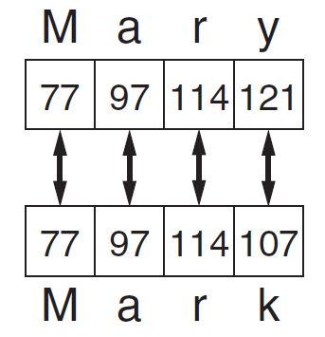
Comparing Strings (cont’d.)
→ Mary > Mark
→ ord(‘M’) = 77 → chr(77) = ‘M‘

Slide 64
Nested Decision Structures and the if-elif-else Statement
A decision structure can be nested inside another decision structure
Commonly needed in programs
Example:
Determine if someone qualifies for a loan, they must meet two conditions:
Must earn at least $30,000/year
Must have been employed for at least two years
Check first condition, and if it is true, check second condition

Slide 65
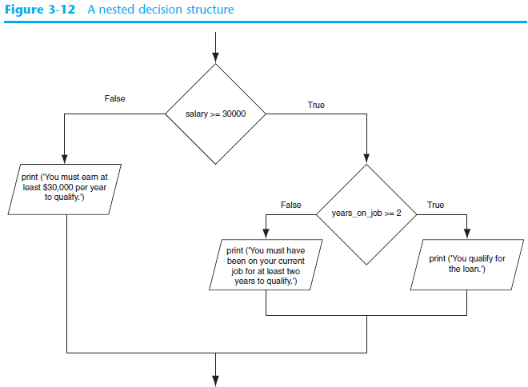

Slide 66
Nested Decision Structures and the if-elif-else Statement (cont’d.)
Important to use proper indentation in a nested decision structure
Important for Python interpreter
Makes code more readable for programmer
Rules for writing nested if statements:
else clause should align with matching if clause
Statements in each block must be consistently indented

Slide 67
The if-elif-else Statement
if-elif-else statement: special version of a decision structure
Makes logic of nested decision structures simpler to write
Can include multiple elif statements
Syntax: if condition1
statements
elif condition2
statements
else
statements

Slide 68
The if-elif-else Statement (cont’d.)
Alignment used with if-elif-else statement:
if, elif, and else clauses are all aligned
Conditionally executed blocks are consistently indented
if-elif-else statement is never required, but logic easier to follow
Can be accomplished by nested if-else
Code can become complex, and indentation can cause problematic long lines

Slide 69
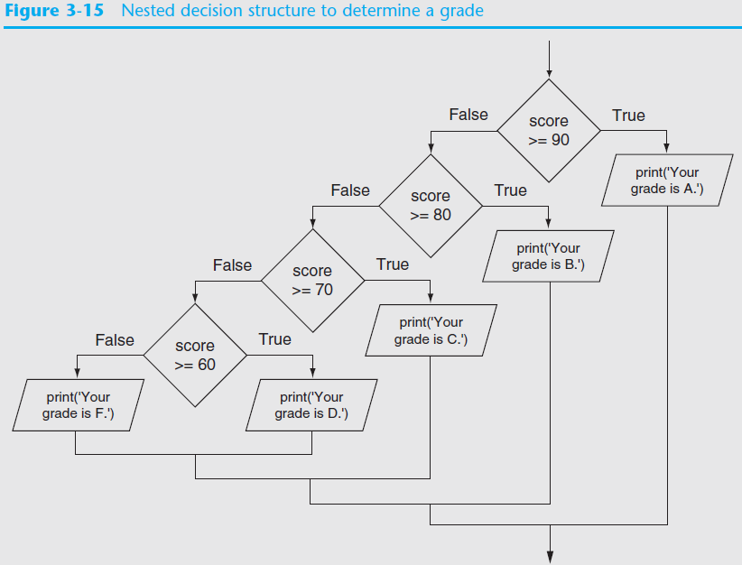

Slide 70
Logical Operators
Logical operators: operators that can be used to create complex Boolean expressions
and operator and or operator: binary operators, connect two Boolean expressions into a compound Boolean expression
not operator: unary operator, reverses the truth of its Boolean operand

Slide 71
The and Operator
Takes two Boolean expressions as operands
Creates compound Boolean expression that is true only when both sub expressions are true
Can be used to simplify nested decision structures
Truth table for
the and operator
Value of the Expression | Expression
false | false and false
false | false and true
false | true and false
true | true and true

Slide 72
The or Operator
Takes two Boolean expressions as operands
Creates compound Boolean expression that is true when either of the sub expressions is true
Can be used to simplify nested decision structures
Truth table for
the or operator
Value of the Expression | Expression
false | false and false
true | false and true
true | true and false
true | true and true

Slide 73
Short-Circuit Evaluation
Short circuit evaluation: deciding the value of a compound Boolean expression after evaluating only one sub expression
Performed by the or and and operators
For or operator: If left operand is true, compound expression is true. Otherwise, evaluate right operand
For and operator: If left operand is false, compound expression is false. Otherwise, evaluate right operand

Slide 74
The not Operator
Takes one Boolean expressions as operand and reverses its logical value
Sometimes it may be necessary to place parentheses around an expression to clarify to what you are applying the not operator
Truth table for the not operator
Value of the Expression | Expression
false | true
true | false

Slide 75
Checking Numeric Ranges with Logical Operators
To determine whether a numeric value is within a specific range of values, use and
Example: x >= 10 and x <= 20
→ you can do this 10<=x<=20, but I do not like it
To determine whether a numeric value is outside of a specific range of values, use or
Example: x < 10 or x > 20

Slide 76
Boolean Variables
Boolean variable: references one of two values, True or False
Represented by bool data type
For example, continue_flag = True
Commonly used as flags
Flag: variable that signals when some condition exists in a program
Flag set to False → condition does not exist
Flag set to True → condition exists

Slide 77
# This program determines whether a bank customer
# qualifies for a loan.
min_salary = 30000.0 # The minimum annual salary
min_years = 2 # The minimum years on the job
# Get the customer's annual salary.
salary = float(input('Enter your annual salary: '))
# Get the number of years on the current job.
years_on_job = int(input('Enter the number of ' +
'years employed: '))
# Determine whether the customer qualifies.
if salary >= min_salary or years_on_job >= min_years:
print('You qualify for the loan.')
else:
print('You do not qualify for this loan.')

Slide 78
None Type
None type: as nothing or NULL
For example, container = None
Decide the usage later

Slide 79
Miscellaneous
The use of “is”
if continuous_flag is True:
if continuous_flag is not True:
if container is None:
Apply the “is” in judgement only → use to judge Boolean or None
The “is” can be used to judge if two variable are located in the same memory space

Slide 80
Summary
This chapter covered:
Decision structures, including:
Single alternative decision structures
Dual alternative decision structures
Nested decision structures
Relational operators and logical operators as used in creating Boolean expressions
String comparison as used in creating Boolean expressions
Boolean variables

Slide 81
C H A P T E R 4
Repetition structures

Slide 82
Topics
Introduction to Repetition Structures
The while Loop: a Condition-Controlled Loop
The for Loop: a Count-Controlled Loop
Calculating a Running Total
Sentinels
Input Validation Loops
Nested Loops

Slide 83
Introduction to Repetition Structures
Often have to write code that performs the same task multiple times
Disadvantages to duplicating code
Makes program large
Time consuming
May need to be corrected in many places
Repetition structure: makes computer repeat included code as necessary
Includes condition-controlled loops and count-controlled loops

Slide 84
The while Loop: a Condition-Controlled Loop
while loop: while condition is true, do something
Two parts:
Condition tested for true or false value
Statements repeated as long as condition is true
In flow chart, line goes back to previous part
General format:
while condition:
statements

Slide 85
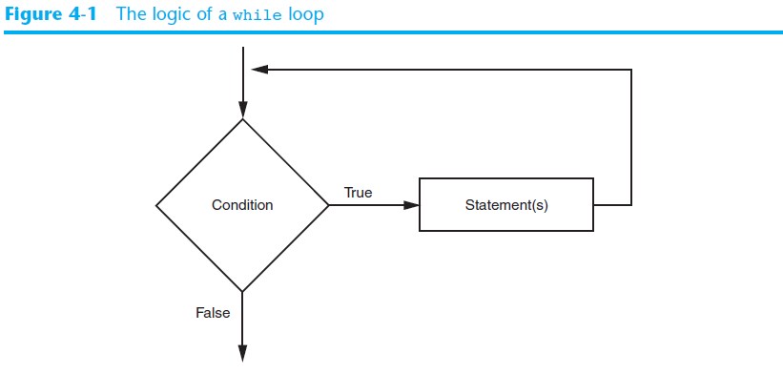
The while Loop: a Condition-Controlled Loop (cont’d.)

Slide 86
The while Loop: a Condition-Controlled Loop (cont’d.)
In order for a loop to stop executing, something has to happen inside the loop to make the condition false
Iteration: one execution of the body of a loop
while loop is known as a pretest loop
Tests condition before performing an iteration
Will never execute if condition is false to start with
Requires performing some steps prior to the loop

Slide 87
# This program calculates sales commissions.
# Create a variable to control the loop.
keep_going = 'y'
# Calculate a series of commissions.
while keep_going == 'y':
# Get a salesperson's sales and commission rate.
sales = float(input('Enter the amount of sales: '))
comm_rate = float(input('Enter the commission rate: '))
# Calculate the commission.
commission = sales * comm_rate
# Display the commission.
print('The commission is $', \
format(commission, ',.2f'), sep='')
# See if the user wants to do another one.
keep_going = input('Do you want to calculate another ' + \
'commission (Enter y for yes): ')

Slide 88
# Create a variable to represent the maximum
# temperature.
max_temp = 102.5
# Get the substance's temperature.
temperature = float(input("Enter the substance's Celsius temperature: "))
# As long as necessary, instruct the user to
# adjust the thermostat.
while temperature > max_temp:
print('The temperature is too high.')
print('Turn the thermostat down and wait')
print('5 minutes. Then take the temperature')
print('again and enter it.')
temperature = float(input('Enter the new Celsius temperature: '))
# Remind the user to check the temperature again
# in 15 minutes.
print('The temperature is acceptable.')
print('Check it again in 15 minutes.')

Slide 89
Infinite Loops
Loops must contain within themselves a way to terminate
Something inside a while loop must eventually make the condition false
Infinite loop: loop that does not have a way of stopping
Repeats until program is interrupted
Occurs when programmer forgets to include stopping code in the loop

Slide 90
while True:
# Get a salesperson's sales and commission rate.
sales = float(input('Enter the amount of sales: '))
comm_rate = float(input('Enter the commission rate: '))
# Calculate the commission.
commission = sales * comm_rate
# Display the commission.
print('The commission is $', \
format(commission, ',.2f'), sep='')

Slide 91
The for Loop: a Count-Controlled Loop
Count-Controlled loop: iterates a specific number of times
Use a for statement to write count-controlled loop
Designed to work with sequence of data items
Iterates once for each item in the sequence
General format:
for variable in [val1, val2, etc]:
statements
Target variable: the variable which is the target of the assignment at the beginning of each iteration

Slide 92
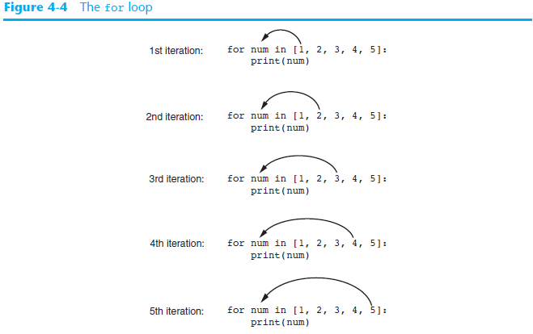

Slide 93
Using the range Function with the for Loop
The range function simplifies the process of writing a for loop
range returns an iterable object
Iterable: contains a sequence of values that can be iterated over
range characteristics:
One argument: used as ending limit
Two arguments: starting value and ending limit
Three arguments: third argument is step value

Slide 94
[0, 1, 2, 3, 4]
for x in range(5):
print(x)
for x in range(1, 5):
print(x)
for x in range(1, 10, 2):
print(x)
[1, 2, 3, 4]
[1, 3, 5, 7, 9]

Slide 95
Using the Target Variable Inside the Loop
Purpose of target variable is to reference each item in a sequence as the loop iterates
Target variable can be used in calculations or tasks in the body of the loop
Example: calculate square root of each number in a range

Slide 96
# This program uses a loop to display a
# table showing the numbers 1 through 10
# and their squares.
# Print the table headings.
print('Number\tSquare')
print('--------------')
# Print the numbers 1 through 10
# and their squares.
for number in range(1, 11):
square = number**2
print(number, '\t', square)

Slide 97
# This program converts the speeds 60 kph
# through 130 kph (in 10 kph increments)
# to mph.
start_speed = 60 # Starting speed
end_speed = 131 # Ending speed
increment = 10 # Speed increment
conversion_factor = 0.6214 # Conversion factor
# Print the table headings.
print('KPH\tMPH')
print('--------------')
# Print the speeds.
for kph in range(start_speed, end_speed, increment):
mph = kph * conversion_factor
print(kph, '\t', format(mph, '.1f'))

Slide 98
Letting the User Control the Loop Iterations
Sometimes the programmer does not know exactly how many times the loop will execute
Can receive range inputs from the user, place them in variables, and call the range function in the for clause using these variables
Be sure to consider the end cases: range does not include the ending limit

Slide 99
# This program uses a loop to display a
# table of numbers and their squares.
# Get the ending limit.
print('This program displays a list of numbers')
print('(starting at 1) and their squares.')
end = int(input('How high should I go? '))
# Print the table headings.
print()
print('Number\tSquare')
print('--------------')
# Print the numbers and their squares.
for number in range(1, end + 1):
square = number**2
print(number, '\t', square)

Slide 100
# This program uses a loop to display a
# table of numbers and their squares.
# Get the starting value.
print('This program displays a list of numbers')
print('and their squares.')
start = int(input('Enter the starting number: '))
# Get the ending limit.
end = int(input('How high should I go? '))
# Print the table headings.
print()
print('Number\tSquare')
print('--------------')
# Print the numbers and their squares.
for number in range(start, end + 1):
square = number**2
print(number, '\t', square)

Slide 101
Generating an Iterable Sequence that Ranges from Highest to Lowest
The range function can be used to generate a sequence with numbers in descending order
Make sure starting number is larger than end limit, and step value is negative
Example: range (10, 0, -1)

Slide 102
Calculating a Running Total
Programs often need to calculate a total of a series of numbers
Typically include two elements:
A loop that reads each number in series
An accumulator variable
Known as program that keeps a running total: accumulates total and reads in series
At end of loop, accumulator will reference the total

Slide 103
# This program calculates the sum of a series
# of numbers entered by the user.
max = 5 # The maximum number
# Initialize an accumulator variable.
total = 0.0
# Explain what we are doing.
print('This program calculates the sum of')
print(max, 'numbers you will enter.')
# Get the numbers and accumulate them.
for counter in range(max):
number = int(input('Enter a number: '))
total = total + number
# Display the total of the numbers.
print('The total is', total)

Slide 104
The Augmented Assignment Operators
In many assignment statements, the variable on the left side of the = operator also appears on the right side of the = operator
Augmented assignment operators: special set of operators designed for this type of job
Shorthand operators

Slide 105
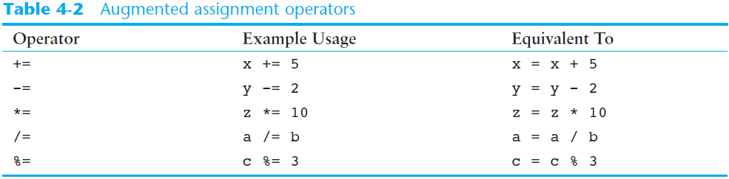
The Augmented Assignment Operators (cont’d.)

Slide 106
Sentinels
Sentinel: special value that marks the end of a sequence of items
When program reaches a sentinel, it knows that the end of the sequence of items was reached, and the loop terminates
Must be distinctive enough so as not to be mistaken for a regular value in the sequence
Example: when reading an input file, empty line can be used as a sentinel

Slide 107
# This program displays property taxes.
TAX_FACTOR = 0.0065 # Represents the tax factor.
# Get the first lot number.
print('Enter the property lot number')
print('or enter 0 to end.')
lot = int(input('Lot number: '))
# Continue processing as long as the user
# does not enter lot number 0.
while lot != 0:
# Get the property value.
value = float(input('Enter the property value: '))
# Calculate the property's tax.
tax = value * TAX_FACTOR
# Display the tax.
print('Property tax: $', format(tax, ',.2f'), sep='')
# Get the next lot number.
print('Enter the next lot number or')
print('enter 0 to end.')
lot = int(input('Lot number: '))

Slide 108
Input Validation Loops
Computer cannot tell the difference between good data and bad data
If user provides bad input, program will produce bad output
GIGO: garbage in, garbage out
It is important to design program such that bad input is never accepted

Slide 109
Input Validation Loops (cont’d.)
Input validation: inspecting input before it is processed by the program
If input is invalid, prompt user to enter correct data
Commonly accomplished using a while loop which repeats as long as the input is bad
If input is bad, display error message and receive another set of data
If input is good, continue to process the input

Slide 110
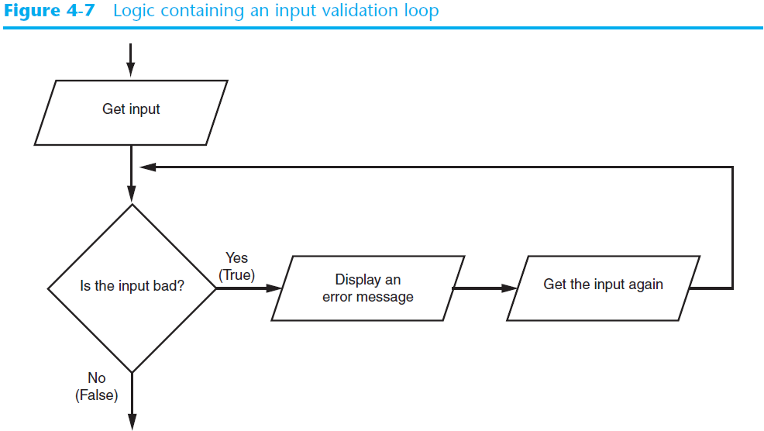
Input Validation Loops (cont’d.)

Slide 111
# This program calculates retail prices.
mark_up = 2.5 # The markup percentage
another = 'y' # Variable to control the loop.
# Process one or more items.
while another == 'y' or another == 'Y':
# Get the item's wholesale cost.
wholesale = float(input("Enter the item's " + "wholesale cost: "))
# Validate the wholesale cost.
while wholesale < 0:
print('ERROR: the cost cannot be negative.')
wholesale = float(input('Enter the correct ' + 'wholesale cost:'))
# Calculate the retail price.
retail = wholesale * mark_up
# Display the retail price.
print('Retail price: $', format(retail, ',.2f'))
# Do this again?
another = input('Do you have another item? ' + '(Enter y for yes): ')

Slide 112
Nested Loops
Nested loop: loop that is contained inside another loop
Example: analog clock works like a nested loop
Hours hand moves once for every twelve movements of the minutes hand: for each iteration of the “hours,” do twelve iterations of “minutes”
Seconds hand moves 60 times for each movement of the minutes hand: for each iteration of “minutes,” do 60 iterations of “seconds”

Slide 113
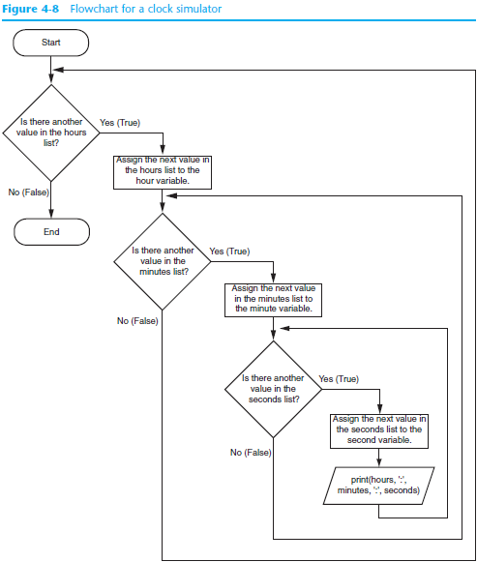

Slide 114
Nested Loops (cont’d.)
Key points about nested loops:
Inner loop goes through all of its iterations for each iteration of outer loop
Inner loops complete their iterations faster than outer loops
Total number of iterations in nested loop: number_iterations_inner x
number_iterations_outer

Slide 115
# Get the number of students.
num_students = int(input('How many students do you have? '))
# Get the number of test scores per student.
num_test_scores = int(input('How many scores per student? '))
# Determine each students average test score.
for student in range(num_students):
# Initialize an accumulator for test scores.
total = 0.0
# Get a student's test scores.
print('Student number', student + 1)
print('-----------------')
for test_num in range(num_test_scores):
print('Test number', test_num + 1, end='')
score = float(input(': '))
# Add the score to the accumulator.
total += score
# Calculate the average test score for this student.
average = total / num_test_scores
# Display the average.
print('The average for student number', student + 1, \
'is:', format(average, '.1f'))

Slide 116
Summary
This chapter covered:
Repetition structures, including:
Condition-controlled loops
Count-controlled loops
Nested loops
Infinite loops and how they can be avoided
range function as used in for loops
Calculating a running total and augmented assignment operators
Use of sentinels to terminate loops

Slide 117
C H A P T E R 5
Functions

Slide 118
Topics
Introduction to Functions
Defining and Calling a Void Function
Designing a Program to Use Functions
Local Variables
Passing Arguments to Functions
Global Variables and Global Constants

Slide 119
Topics (cont’d.)
Introduction to Value-Returning Functions: Generating Random Numbers
Writing Your Own Value-Returning Functions
The math Module
Storing Functions in Modules

Slide 120
Introduction to Functions
Function: group of statements within a program that perform as specific task
Usually one task of a large program
Functions can be executed in order to perform overall program task
Known as divide and conquer approach
Modularized program: program wherein each task within the program is in its own function

Slide 121
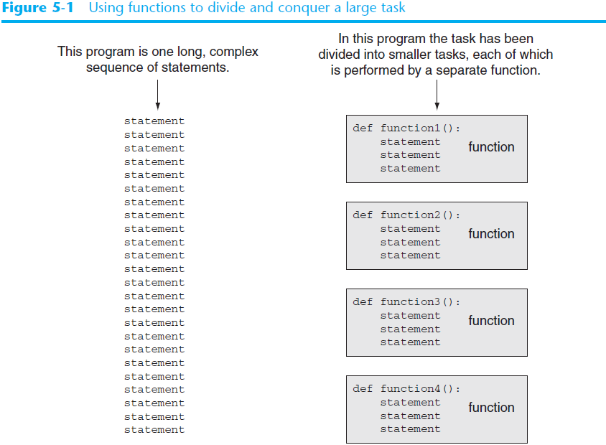

Slide 122
Benefits of Modularizing a Program with Functions
The benefits of using functions include:
Simpler code
Code reuse
write the code once and call it multiple times
Better testing and debugging
Can test and debug each function individually
Faster development
Easier facilitation of teamwork
Different team members can write different functions

Slide 123
Void Functions and Value-Returning Functions
A void function:
Simply executes the statements it contains and then terminates.
A value-returning function:
Executes the statements it contains, and then it returns a value back to the statement that called it.
The input, int, and float functions are examples of value-returning functions.

Slide 124
Defining and Calling a Function
Functions are given names
Function naming rules:
Cannot use key words as a function name
Cannot contain spaces
First character must be a letter or underscore
All other characters must be a letter, number or underscore
Uppercase and lowercase characters are distinct

Slide 125
Defining and Calling a Function (cont’d.)
Function name should be descriptive of the task carried out by the function
Often includes a verb
Function definition: specifies what function does
def function_name():
statement
statement
# function name → small characters with underlines

Slide 126
Defining and Calling a Function (cont’d.)
Function header: first line of function
Includes keyword def and function name, followed by parentheses and colon
Block: set of statements that belong together as a group
Example: the statements included in a function

Slide 127
Defining and Calling a Function (cont’d.)
Call a function to execute it
When a function is called:
Interpreter jumps to the function and executes statements in the block
Interpreter jumps back to part of program that called the function
Known as function return

Slide 128
# This program demonstrates a function.
# First, we define a function named message.
def message():
print('I am Arthur')
print('King of the Britons')
# Call the message function.
message()

Slide 129
Defining and Calling a Function (cont’d.)
main function: called when the program starts
Calls other functions when they are needed
Defines the mainline logic of the program
Actually, no main function is needed in Python
But, you can still have a main function for clarify

Slide 130
# This program has two functions. First we
# define the main function.
def main():
print('I have a message for you.')
message()
print('Goodbye!')
# Next we define the message function.
def message():
print('I am Arthur')
print('King of the Britons.')
# Call the main function.
main()

Slide 131
Indentation in Python
Each block must be indented
Lines in block must begin with the same number of spaces
Use tabs or spaces to indent lines in a block, but not both as this can confuse the Python interpreter
IDLE automatically indents the lines in a block
Blank lines that appear in a block are ignored

Slide 132
Designing a Program to Use Functions
In a flowchart, function call shown as rectangle with vertical bars at each side
Function name written in the symbol
Typically draw separate flow chart for each function in the program
End terminal symbol usually reads Return
Top-down design: technique for breaking algorithm into functions

Slide 133
Designing a Program to Use Functions (cont’d.)
Hierarchy chart: depicts relationship between functions
AKA structure chart
Box for each function in the program, Lines connecting boxes illustrate the functions called by each function
Does not show steps taken inside a function

Slide 134
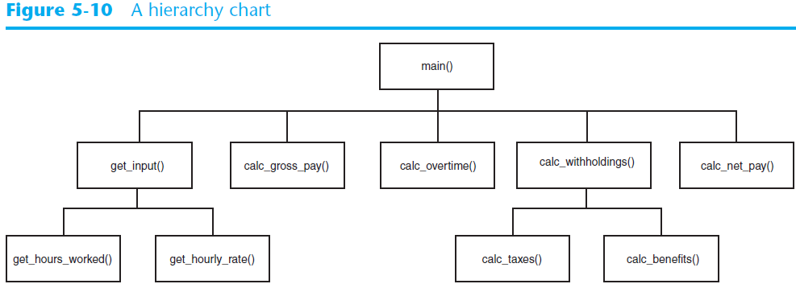
Designing a Program to Use Functions (cont’d.)

Slide 135
Local Variables
Local variable: variable that is assigned a value inside a function
Belongs to the function in which it was created
Only statements inside that function can access it, error will occur if another function tries to access the variable
Scope: the part of a program in which a variable may be accessed
For local variable: function in which created

Slide 136
# Definition of the main function.
def main():
get_name()
print('Hello', name) # This causes an error!
# Definition of the get_name function.
def get_name():
name = input('Enter your name: ')
# Call the main function.
main()

Slide 137
Local Variables (cont’d.)
Local variable cannot be accessed by statements inside its function which precede its creation
You should create local variable before using
Different functions may have local variables with the same name
Each function does not see the other function’s local variables, so no confusion

Slide 138
# This program demonstrates two functions that
# have local variables with the same name.
def main():
# Call the texas function.
texas()
# Call the california function.
california()
# Definition of the texas function. It creates
# a local variable named birds.
def texas():
birds = 5000
print('texas has', birds, 'birds.')
# Definition of the california function. It also
# creates a local variable named birds.
def california():
birds = 8000
print('california has', birds, 'birds.')
# Call the main function.
main()

Slide 139
Passing Arguments to Functions
Argument: piece of data that is sent into a function
Function can use argument in calculations
When calling the function, the argument is placed in parentheses following the function name

Slide 140
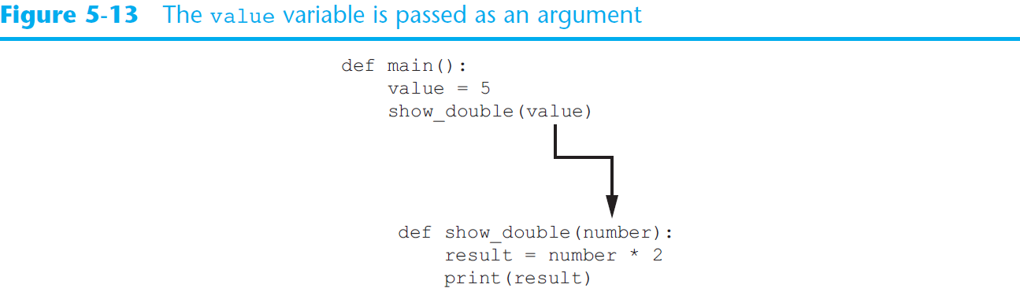
Passing Arguments to Functions (cont’d.)

Slide 141
Passing Arguments to Functions (cont’d.)
Parameter variable: variable that is assigned the value of an argument when the function is called
The parameter and the argument reference the same value
General format:
def function_name(parameter):
Scope of a parameter: the function in which the parameter is used

Slide 142
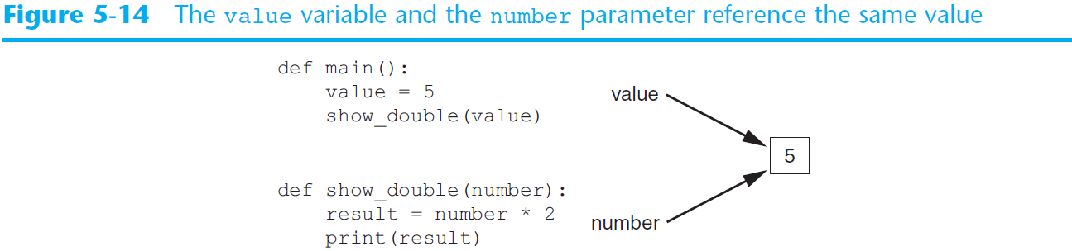
Passing Arguments to Functions (cont’d.)

Slide 143
def main():
# display the intro screen.
intro()
# Get the number of cups.
cups_needed = int(input('Enter the number of cups: '))
# Convert the cups to ounces.
cups_to_ounces(cups_needed)
# The intro function displays an introductory screen.
def intro():
print('This program converts measurements')
print('in cups to fluid ounces. For your')
print('reference the formula is:')
print(' 1 cup = 8 fluid ounces')
# The cups_to_ounces function accepts a number of
# cups and displays the equivalent number of ounces.
def cups_to_ounces(cups):
ounces = cups * 8
print('That converts to', ounces, 'ounces.')
# Call the main function.
main()

Slide 144
Passing Multiple Arguments
Python allows writing a function that accepts multiple arguments
Parameter list replaces single parameter
Parameter list items separated by comma
Arguments are passed by position to corresponding parameters
First parameter receives value of first argument, second parameter receives value of second argument, etc.

Slide 145
# This program demonstrates a function that accepts
# two arguments.
def main():
print('The sum of 12 and 45 is')
show_sum(12, 45)
# The show_sum function accepts two arguments
# and displays their sum.
def show_sum(num1, num2):
result = num1 + num2
print(result)
# Call the main function.
main()

Slide 146
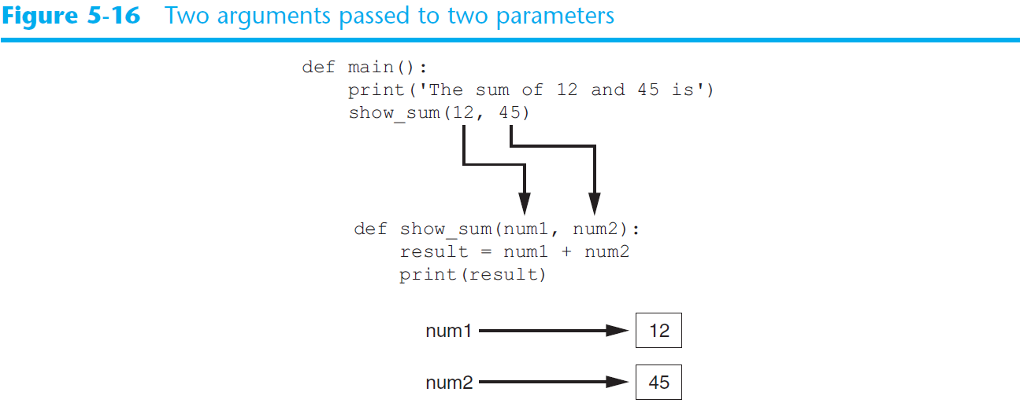
Passing Multiple Arguments (cont’d.)

Slide 147
Making Changes to Parameters
Changes made to a parameter value within the function do not affect the argument
Known as pass by value
Provides a way for unidirectional communication between one function and another function
Calling function can communicate with called function

Slide 148
# This program demonstrates what happens when you
# change the value of a parameter.
def main():
value = 99
print('The value is', value)
change_me(value)
print('Back in main the value is', value)
def change_me(arg):
print('I am changing the value.')
arg = 0
print('Now the value is', arg)
# Call the main function.
main()

Slide 149
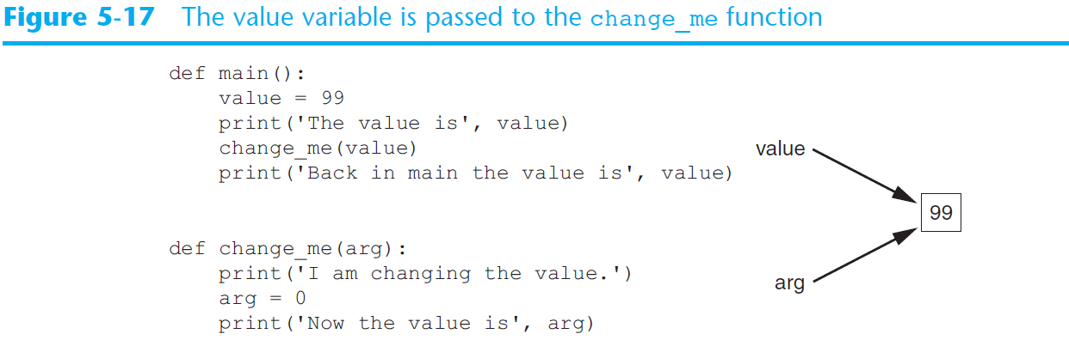
Making Changes to Parameters (cont’d.)

Slide 150
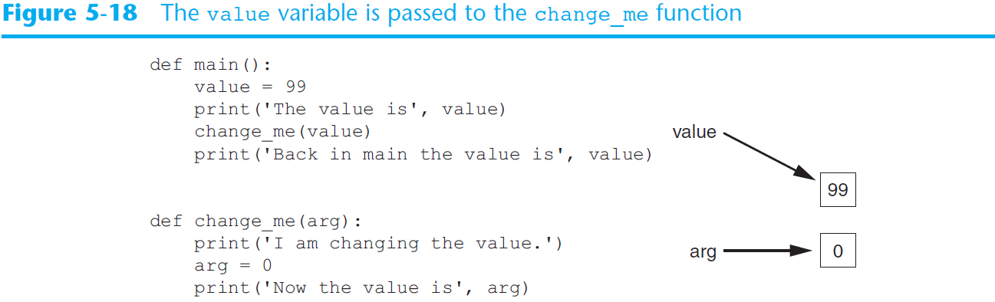
Making Changes to Parameters (cont’d.)
Figure 5-18
The value variable passed to the change_me function cannot be changed by it

Slide 151
Keyword Arguments
Keyword argument: argument that specifies which parameter the value should be passed to
Position when calling function is irrelevant
General Format:
function_name(parameter=value)
Possible to mix keyword and positional arguments when calling a function
Positional arguments must appear first

Slide 152
# This program demonstrates keyword arguments.
def main():
# Show the amount of simple interest using 0.01 as
# interest rate per period, 10 as the number of periods,
# and $10,000 as the principal.
show_interest(rate=0.01, periods=10, principal=10000.0)
# The show_interest function displays the amount of
# simple interest for a given principal, interest rate
# per period, and number of periods.
def show_interest(principal, rate, periods): # unseq .. ok!
interest = principal * rate * periods
print('The simple interest will be $', \
format(interest, ',.2f'), \
sep='')
# Call the main function.
main()

Slide 153
# This program demonstrates passes two strings as
# keyword arguments to a function.
def main():
first_name = input('Enter your first name: ')
last_name = input('Enter your last name: ')
print('Your name reversed is')
reverse_name(last=last_name, first=first_name)
def reverse_name(first, last):
print(last, first)
# Call the main function.
main()
#####################################
# You can mix the usage like …
show_interest(1000.0, rate=0.01, periods=10)
# But positional arguments should show up earlier

Slide 154
Default Arguments
Default argument: give default value to arguments
def show_interest(principal, rate = 0.1, periods=0.9):
interest = principal * rate * periods
print('The simple interest will be $', \
format(interest, ',.2f'), \
sep='')
# Call the function.
show_interest(0.2, 0.4, 0.5)
show_interest(0.3)

Slide 155
Global Variables and Global Constants
Global variable: created by assignment statement written outside all the functions
Can be accessed by any statement in the program file, including from within a function
If a function needs to assign a value to the global variable, the global variable must be redeclared within the function
General format: global variable_name

Slide 156
# Create a global variable.
my_value = 10
# The show_value function prints
# the value of the global variable.
def show_value():
print(my_value)
# Call the show_value function.
show_value()
# Create a global variable.
number = 0
def main():
global number
number = int(input('Enter a number: '))
show_number()
def show_number():
print('The number you entered is', number)
# Call the main function.
main()

Slide 157
Global Variables and Global Constants (cont’d.)
Reasons to avoid using global variables:
Global variables making debugging difficult
Many locations in the code could be causing a wrong variable value
Functions that use global variables are usually dependent on those variables
Makes function hard to transfer to another program
Global variables make a program hard to understand

Slide 158
Global Constants
Global constant: global name that references a value that cannot be changed
Permissible to use global constants in a program
To simulate global constant in Python, create global variable and do not re-declare it within functions

Slide 159
# The following is used as a global constant to represent
# the contribution rate.
CONTRIBUTION_RATE = 0.05
def main():
gross_pay = float(input('Enter the gross pay: '))
bonus = float(input('Enter the amount of bonuses: '))
show_pay_contrib(gross_pay)
show_bonus_contrib(bonus)
def show_pay_contrib(gross):
contrib = gross * CONTRIBUTION_RATE
print('Contribution for gross pay: $', \
format(contrib, ',.2f'), \
sep='')
def show_bonus_contrib(bonus):
contrib = bonus * CONTRIBUTION_RATE
print('Contribution for bonuses: $', \
format(contrib, ',.2f'), \
sep='')
# Call the main function.
main()

Slide 160
Introduction to Value-Returning Functions: Generating Random Numbers
void function: group of statements within a program for performing a specific task
Call function when you need to perform the task
Value-returning function: similar to void function, returns a value
Value returned to part of program that called the function when function finishes executing

Slide 161
Standard Library Functions and the import Statement
Standard library: library of pre-written functions that comes with Python
Library functions perform tasks that programmers commonly need
Example: print, input, range
Viewed by programmers as a “black box”
Some library functions built into Python interpreter
To use, just call the function

Slide 162
Standard Library Functions and the import Statement (cont’d.)
Modules: files that stores functions of the standard library
Help organize library functions not built into the interpreter
Copied to computer when you install Python
To call a function stored in a module, need to write an import statement
Written at the top of the program
Format: import module_name

Slide 163
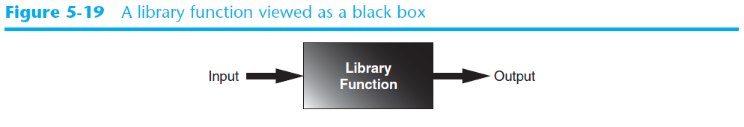
Standard Library Functions and the import Statement (cont’d.)

Slide 164
Generating Random Numbers
Random number are useful in a lot of programming tasks
random module: includes library functions for working with random numbers
Dot notation: notation for calling a function belonging to a module
Format: module_name.function_name()

Slide 165
Generating Random Numbers (cont’d.)
randint function: generates a random number in the range provided by the arguments
Returns the random number to part of program that called the function
Returned integer can be used anywhere that an integer would be used
You can experiment with the function in interactive mode

Slide 166
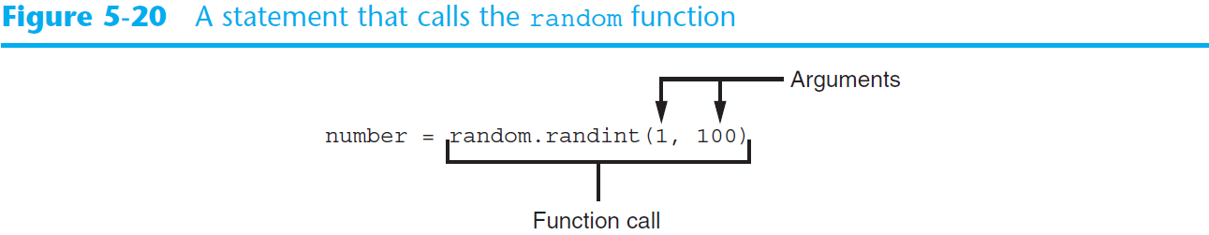
Generating Random Numbers (cont’d.)

Slide 167
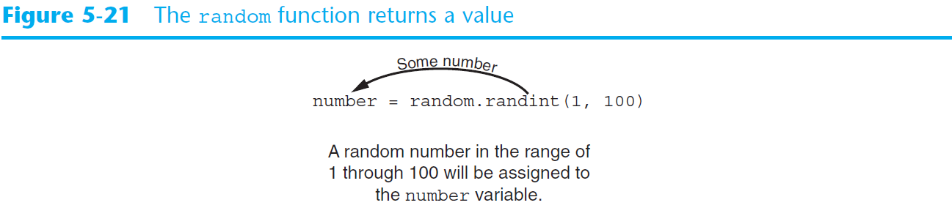
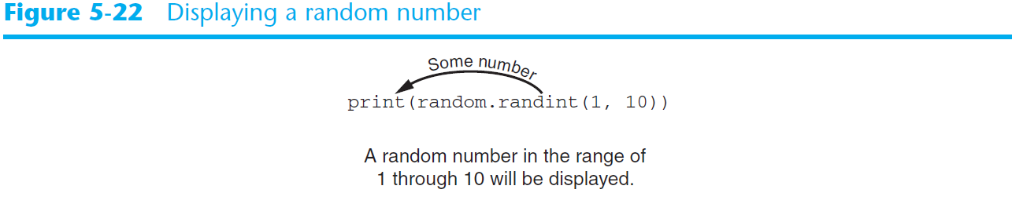
Generating Random Numbers (cont’d.)

Slide 168
# This program displays a random number
# in the range of 1 through 10.
import random
def main():
# Get a random number.
number = random.randint(1, 10)
# Display the number.
print('The number is', number)
# Call the main function.
main()
# This program displays five random
# numbers in the range of 1 through 100.
import random
def main():
for count in range(5):
print(random.randint(1, 100))
# Call the main function.
main()

Slide 169
# This program simulates the rolling of dice.
import random
# Constants for the minimum and maximum random numbers
MIN = 1
MAX = 6
def main():
# Create a variable to control the loop.
again = 'y'
# Simulate rolling the dice.
while again == 'y' or again == 'Y':
print('Rolling the dice...')
print('Their values are:')
print(random.randint(MIN, MAX))
print(random.randint(MIN, MAX))
# Do another roll of the dice?
again = input('Roll them again? (y = yes): ')
# Call the main function.
main()

Slide 170
# This program simulates 10 tosses of a coin.
import random
# Constants
HEADS = 1
TAILS = 2
TOSSES = 10
def main():
for toss in range(TOSSES):
# Simulate the coin toss.
if random.randint(HEADS, TAILS) == HEADS:
print('Heads')
else:
print('Tails')
# Call the main function.
main()

Slide 171
Generating Random Numbers (cont’d.)
randrange function: similar to range function, but returns randomly selected integer from the resulting sequence
Same arguments as for the range function
random function: returns a random float in the range of 0.0 and 1.0
Does not receive arguments
uniform function: returns a random float but allows user to specify range

Slide 172
Random Number Seeds
Random number created by functions in random module are actually pseudo-random numbers
Seed value: initializes the formula that generates random numbers
Need to use different seeds in order to get different series of random numbers
By default uses system time for seed
Can use random.seed() function to specify desired seed value, e.g., random.seed(10)

Slide 173
Writing Your Own Value-Returning Functions
To write a value-returning function, you write a simple function and add one or more return statements
Format: return expression
The value for expression will be returned to the part of the program that called the function
The expression in the return statement can be a complex expression, such as a sum of two variables or the result of another value- returning function

Slide 174
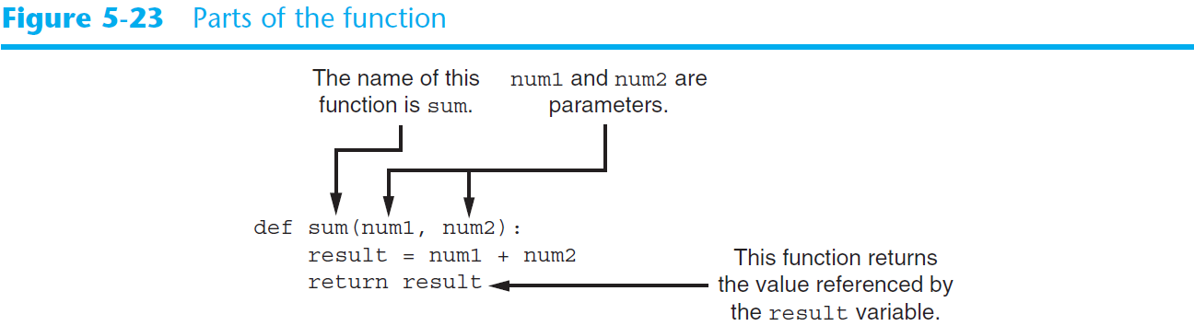
Writing Your Own Value-Returning Functions (cont’d.)

Slide 175
# This program uses the return value of a function.
def main():
# Get the user's age.
first_age = int(input('Enter your age: '))
# Get the user's best friend's age.
second_age = int(input("Enter your best friend's age: "))
# Get the sum of both ages.
total = sum(first_age, second_age)
# Display the total age.
print('Together you are', total, 'years old.')
# The sum function accepts two numeric arguments and
# returns the sum of those arguments.
def sum(num1, num2):
result = num1 + num2
return result
# Call the main function.
main()

Slide 176
How to Use Value-Returning Functions
Value-returning function can be useful in specific situations
Example: have function prompt user for input and return the user’s input
Simplify mathematical expressions
Complex calculations that need to be repeated throughout the program
Use the returned value
Assign it to a variable or use as an argument in another function

Slide 177
DISCOUNT_PERCENTAGE = 0.20
# The main function.
def main():
reg_price = get_regular_price()
sale_price = reg_price - discount(reg_price)
print('The sale price is $', format(sale_price, ',.2f'), sep='')
# The get_regular_price function prompts the
# user to enter an item's regular price and it
# returns that value.
def get_regular_price():
price = float(input("Enter the item's regular price: "))
return price
# The discount function accepts an item's price
# as an argument and returns the amount of the
# discount, specified by DISCOUNT_PERCENTAGE.
def discount(price):
return price * DISCOUNT_PERCENTAGE
# Call the main function.
main()

Slide 178
def main():
sales = get_sales()
advanced_pay = get_advanced_pay()
comm_rate = determine_comm_rate(sales)
pay = sales * comm_rate - advanced_pay
def get_sales():
monthly_sales = float(input('Enter the monthly sales: '))
return monthly_sales
def get_advanced_pay():
print('Enter the amount of advanced pay, or’)
print('enter 0 if no advanced pay was given.’)
advanced = float(input('Advanced pay: ‘))
return advanced
def determine_comm_rate(sales):
if sales < 10000.00:
rate = 0.10
else:
rate = 0.18
return rate
main()

Slide 179
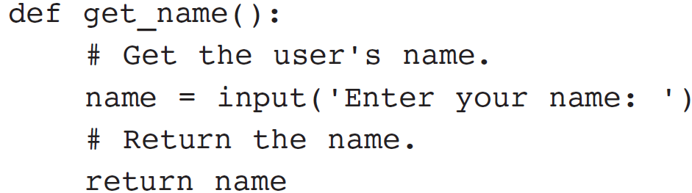
Returning Strings
You can write functions that return strings
For example:

Slide 180
Returning Boolean Values
Boolean function: returns either True or False
Use to test a condition such as for decision and repetition structures
Common calculations, such as whether a number is even, can be easily repeated by calling a function
Use to simplify complex input validation code
Ex: while is_invalid(model):

Slide 181
Returning Multiple Values
In Python, a function can return multiple values
Specified after the return statement separated by commas
For example: return first, last.
When you call such a function in an assignment statement, you need a separate variable on the left side of the = operator to receive each returned value
For example: first_name, last_name = get_name()

Slide 182
The math Module
math module: part of standard library that contains functions that are useful for performing mathematical calculations
Typically accept one or more values as arguments, perform mathematical operation, and return the result
Use of module requires an import math statement

Slide 183
# This program demonstrates the sqrt function.
import math
def main():
# Get a number.
number = float(input('Enter a number: '))
# Get the square root of the number.
square_root = math.sqrt(number)
# Display the square root.
print('The square root of', number, 'is', square_root)
# Call the main function.
main()

Slide 184
# This program calculates the length of a right
# triangle's hypotenuse.
import math
def main():
# Get the length of the triangle's two sides.
a = float(input('Enter the length of side A: '))
b = float(input('Enter the length of side B: '))
# Calculate the length of the hypotenuse.
c = math.hypot(a, b)
# distance between (0, 0) to (a,b)
# Display the length of the hypotenuse.
print('The length of the hypotenuse is', c)
# Call the main function.
main()

Slide 185
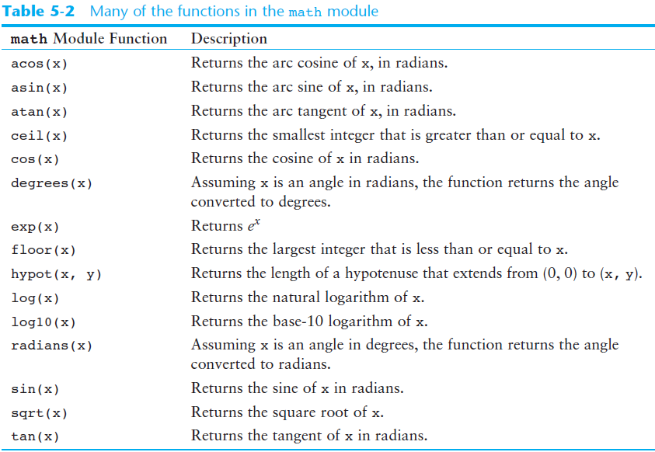
The math Module (cont’d.)

Slide 186
The math Module (cont’d.)
The math module defines variables pi and e, which are assigned the mathematical values for pi and e
Can be used in equations that require these values, to get more accurate results
Variables must also be called using the dot notation
Example:
circle_area = math.pi * radius**2

Slide 187
Storing Functions in Modules
In large, complex programs, it is important to keep code organized
Modularization: grouping related functions in modules
Makes program easier to understand, test, and maintain
Make it easier to reuse code for multiple different programs
Import the module containing the required function to each program that needs it

Slide 188
Storing Functions in Modules (cont’d.)
Module is a file that contains Python code
Contains function definition but does not contain calls to the functions
Importing programs will call the functions
Rules for module names:
File name should end in .py
Cannot be the same as a Python keyword
Import module using import statement

Slide 189
Separate programs into different file
In circle and rectangle, they only contain the needed modules
→ geometry.py → import circle and rectangle
# This program allows the user to choose various
# geometry calculations from a menu. This program
# imports the circle and rectangle modules.
import circle
import rectangle
# Constants for the menu choices
AREA_CIRCLE_CHOICE = 1
………………………… ………………………… …………………………
………………………… ………………………… …………………………

Slide 190
Menu Driven Programs
Menu-driven program: displays a list of operations on the screen, allowing user to select the desired operation
List of operations displayed on the screen is called a menu (as shown in the example before)
Program uses a decision structure to determine the selected menu option and required operation
Typically repeats until the user quits

Slide 191
Summary
This chapter covered:
The advantages of using functions
The syntax for defining and calling a function
Methods for designing a program to use functions
Use of local variables and their scope
Syntax and limitations of passing arguments to functions
Global variables, global constants, and their advantages and disadvantages

Slide 192
Summary (cont’d.)
Value-returning functions, including:
Writing value-returning functions
Using value-returning functions
Functions returning multiple values
Using library functions and the import statement
Modules, including:
The random and math modules
Grouping your own functions in modules

Slide 193
Week 3 Quiz 1
Print
Please enter a value: 7
*******
******
*****
****
***
**
*
**
***
****
*****
******
*******

Slide 194
Week 3 Quiz 2
Print
please enter a value: 7
##
# #
# #
# #
# #
# #
# #
One space
Two space

Slide 195
Week 3 Quiz 3
Print
Please enter odd number 10
Please enter odd number 12
Please enter odd number 9
*
***
*****
*******
*********
*******
*****
***
*
Avoid wrong input

Slide 196
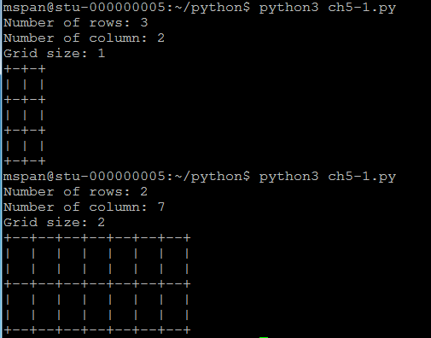
Week 3 Quiz 4

Slide 197
Week 3 Quiz 5
Number guessing game
At least two functions: guessing() and main()
guessing() return if success to main()
You should have a limit on guess times

